Slide 1


Welcome to our English magazine for girls and boys
Meet our editors:

Slide 2
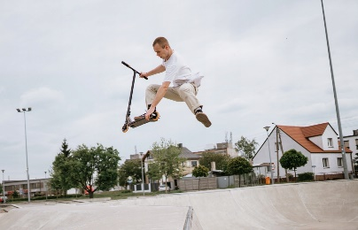
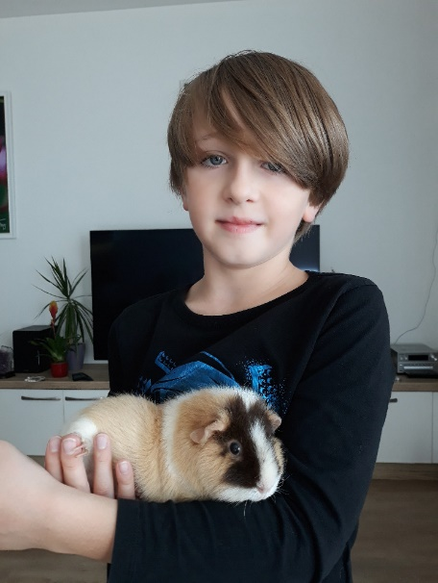
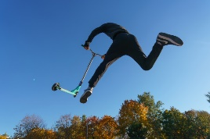
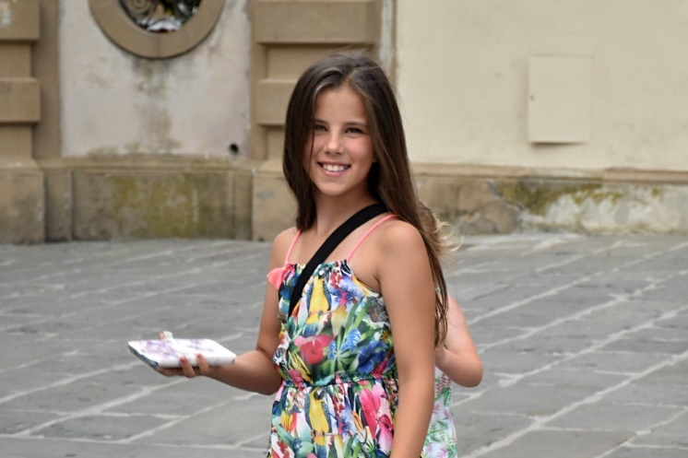
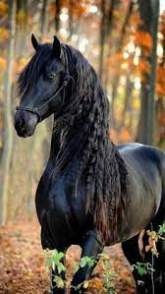
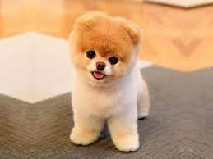
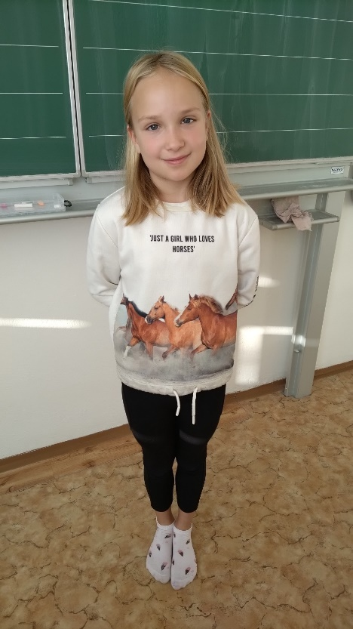
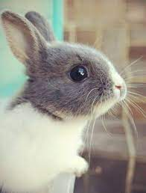
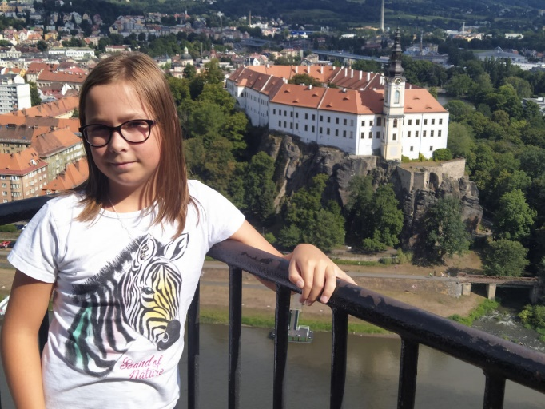
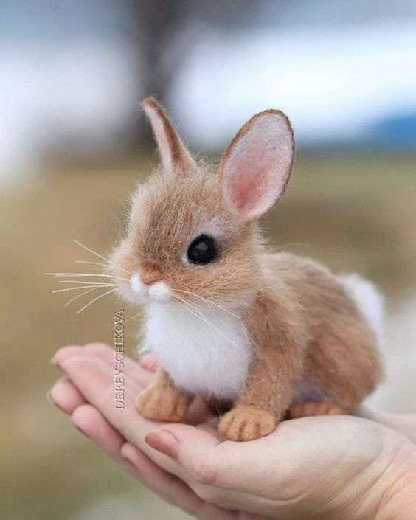
Hello, my name is Adam.
I’m 9 years old.
I like to ride a freestyle scooter.
I play the guitar.
I love to play computer games.
I’ve got one sister.
I’ve got a guinea pig.
Her name is Honey.
I’m from the Czech Republic.
I go to class 4.C at Březinova school.
My name is Aneta Brožová.
I´m ten years old.
I love horses, dogs and chinchillas.
I play floorball.
I´m from the Czech Republic.
I´ve got long brown hair and brown-green eyes.
I´ve got one brother. His name is Filip.
Hello, my name´s Ann.
I´m nine. I like to dance. I love rabbits. I´m from the Czech Republic. I go to class 4.C at Březinova school. I´ve got one sister.
My name is Tereza Nella Nosková.
I´m 10 years old.
I like milk and Mirinda and horses.
My best frend is Šárka.
I play floorball and do acrobatics.

Slide 3
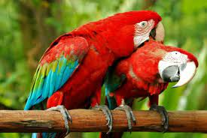
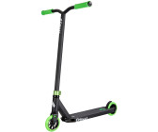
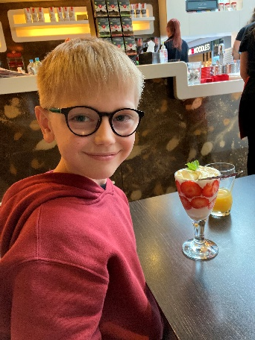
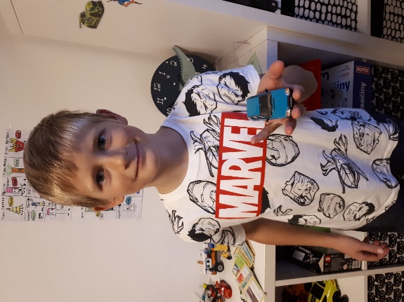
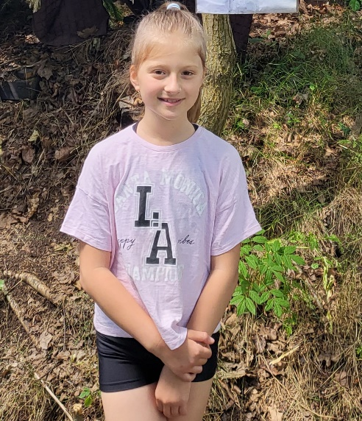
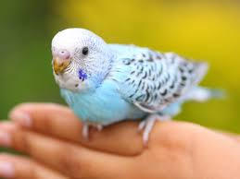
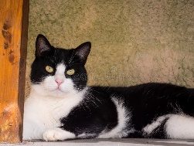
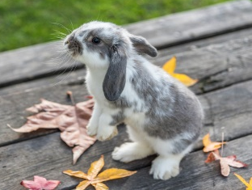
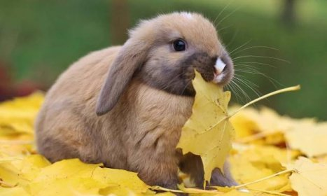
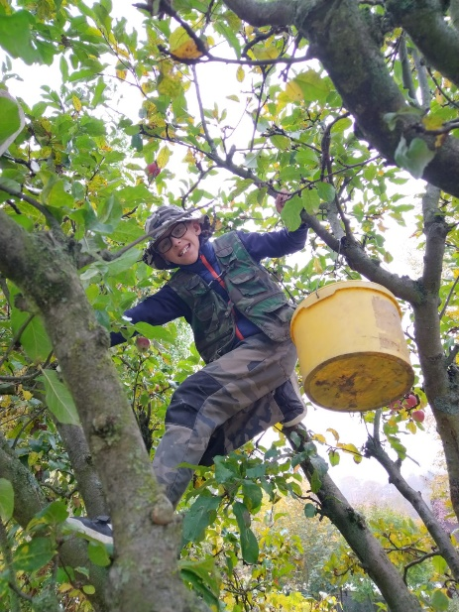
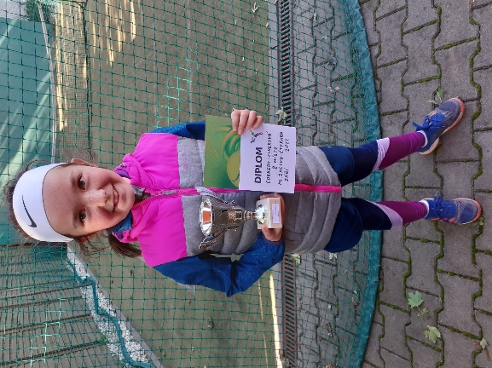
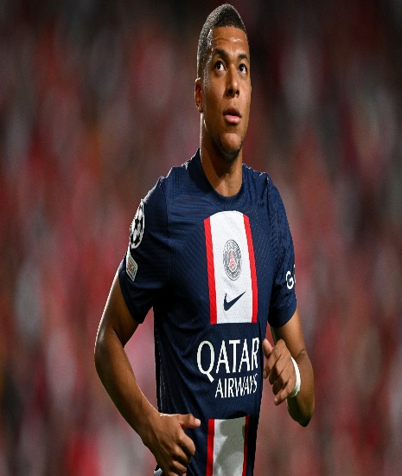
HELLO! My name´s Evelina Fillipov. I´m 9 years old . I like gymnastics. I play the piano and flute. I love dogs . I´m funny. I´ve got long brown hair and brown eyes. I´ve got two sisters .I´ve got a parrot. His name is Irbísek. I´m from the Czech Republic. I go class 4.D at Březinova school.
Hello! My name is Max. I´m ten years old. I like to paint pictures. I play videogames. I love parrots. My friends call me Trnyyy. I´m small and thin. I´ve got short blond hair and green eyes. I´m from the Czech Republic. I live in Jihlava.
Hello in Martin
I´m nine years oldI like to sing (ALONE), dance and play video games with my friends.
My favorite colour is black and red. Im an athlete, I love sports. My favorite food is: pizza, spaghetti and sushi.
I’m a youtuber Felix MCat with 40 subscribers and 19 videos (TODAY).
I’m a scooter rider (begginer). I´m in 4 grade and in class 4.B.
Hallo, my name is Hana Corkery.
I am 10. I´ve got one brother. I am short and smart. I´ve got long brown hair and green eyes.
I am from the Czech Republic. I go to 4.B at Březinova school.
I like playing tennis. I learn to play the piano and flute in a musical school. I love reading books. I am interested in science.
My name´s Jakub.
I´m 10 years old.
I like to ride a bike and scooter.
I play fooball.
I love cats , dogs and rabbits.
I´m friendly.
I´ve got short hair and grey eyes.
I´ve got one brother.
I´ve got a rabbit. His name is Venda.
I´m from the Czech Republic.
I go to class 4.A at Březinova school.

Slide 4
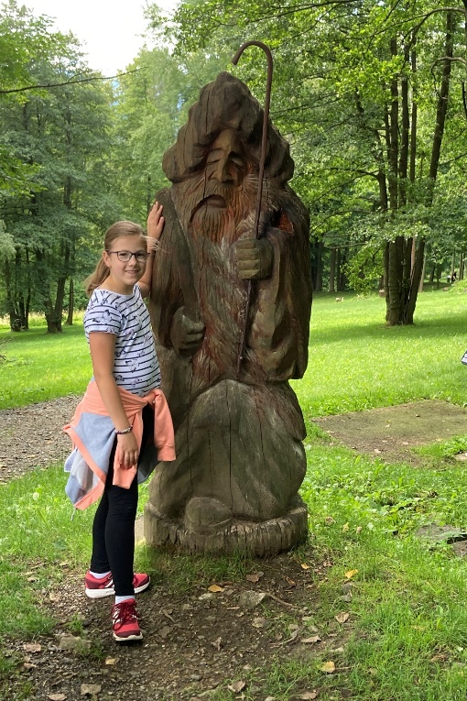
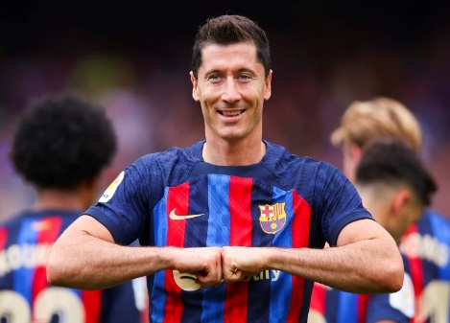
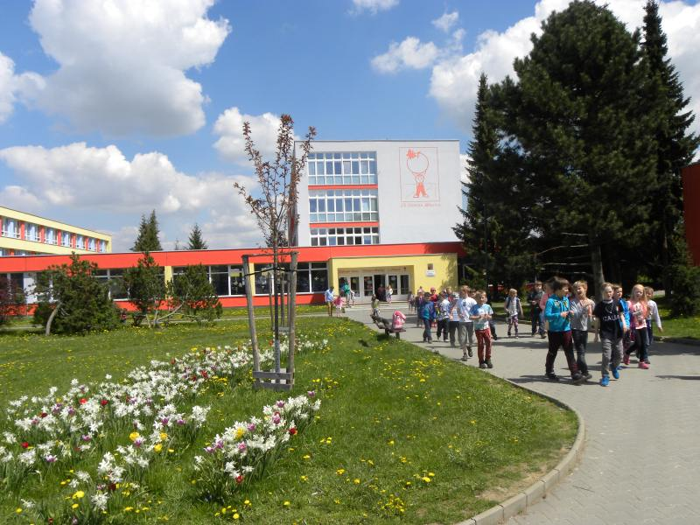
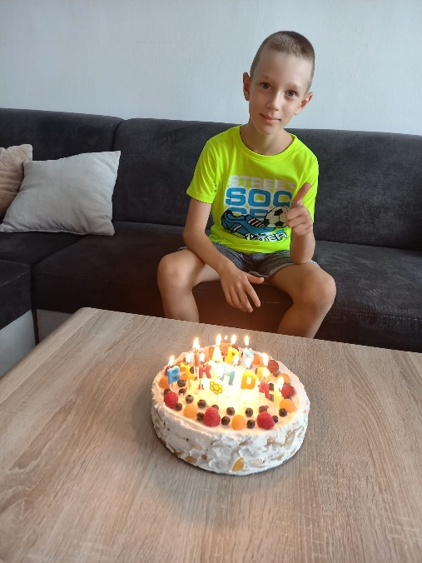

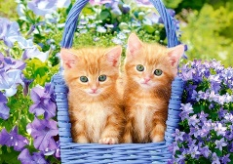
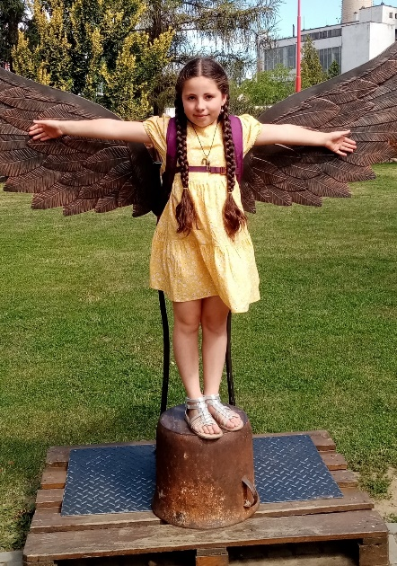
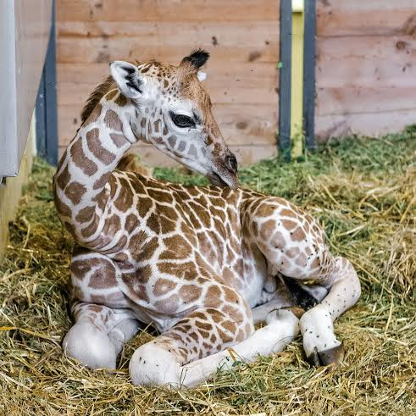
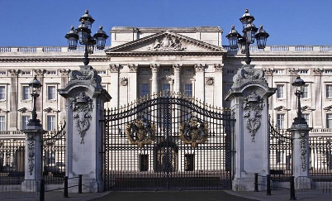
HELLO! My name´s Michaela Adamová. I´m nine years old. I love animals and painting pictures. I have a brother and his name´s James. I love to dance. I have a hamster and his name´s Monty. I play the piano. I like sport and karate. I like fruit. I from the Czech Republic. I like English. I go to class 4.D at Březinova school.
MY NAME IS VICTORIA JANE BEIRNE.
I’M 9 YEARS OLD.
I LIKE TO DANCE, DRAW AND READ MYSTERY BOOKS.
I PLAY THE ACCORDION.
I LOVE KITTENS AND GIRAFFES.
MY FRIENDS CALL ME JAM.
I’M SMALL.
I’VE GOT LONG BROWN HAIR AND BROWN EYES.
I’VE GOT ONE YOUNGER BROTHER CALLED FREDERICK.
I’VE GOT TWO CATS.
THEIR NAMES ARE ŤAPKA AND MOUREČEK.
Hello! My name is Max. I´m 9 years old. I like to play football. I love crocodiles . My friends call me Burák. I´m big and tall. I´ve got short brown hair and blue and green eyes. I´ve got one brother. I´m from the Czech Republic. I go to class 4.c.

Slide 5
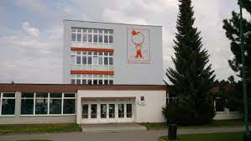
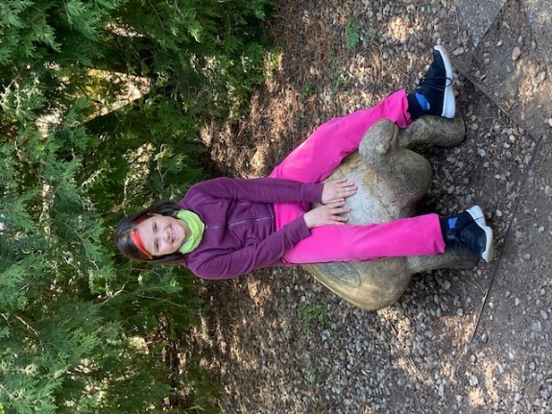
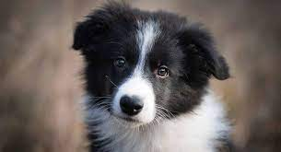
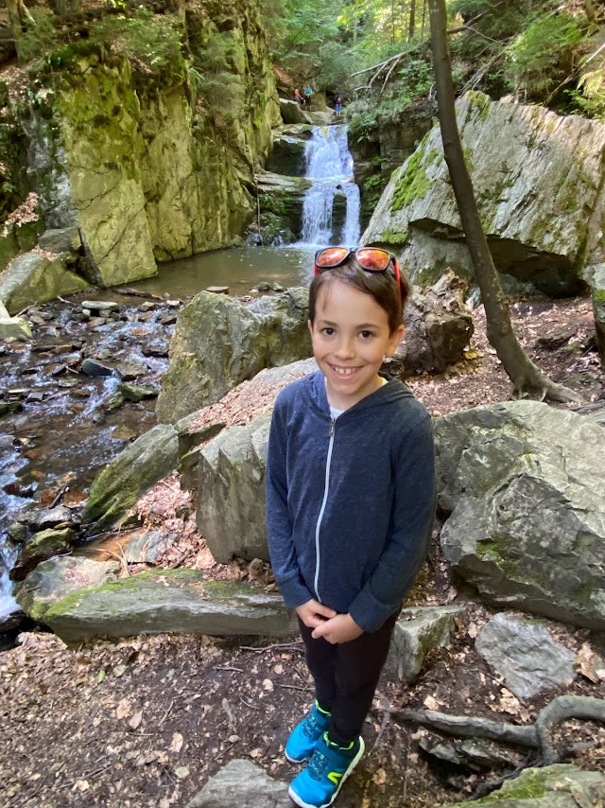
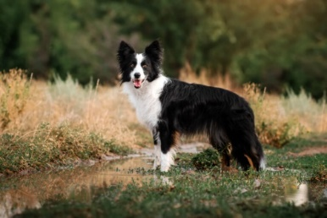
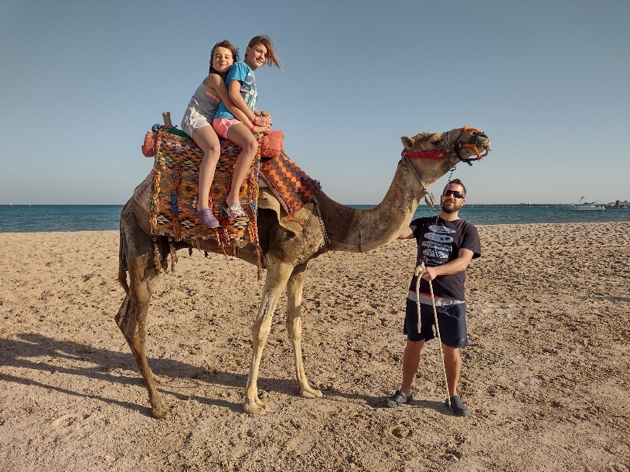
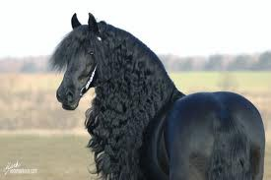
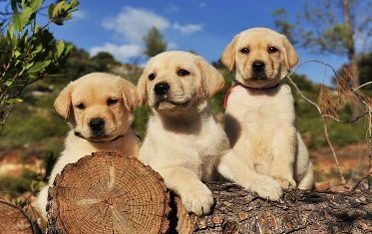
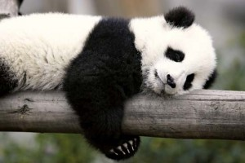
Hello!
My name´s Pavlína Hrubá.
I´m ten years old.
I like to paint pictures.
I play the flute.
I love cats and dogs.
My friends call me Pája.
I´m tall, funny, smart and friendly.
I´ve got short hair and green eyes.
I´ve got one sister, a rabbit, a cat, a dog and guinea pig.
I´ve got a rabbit. His name´s Mrkvička.
I´ve got a cat. Her name is Bibi.
I´ve got a dog. His name´s Denny.
I´ve got a Guinea pig. Her name´s Růženka.
I go to class 4.D at Březinova school. I´m from the Czech Republic.
Hello! My name is Samuel.
I’m 10 years old.
I like to read books, play football and ride a bike.
I play football.
I love dogs and turtles.
I’m friendly.
I’ve got short brown hair.
I’m from the Czech Republic.
I go to class 4.A at Březinova school.
Hello! My name is Viky.
I´m 10 years old. I like horse riding. I like to play with my friend Kačka. I love horses, pandas and dogs. My friends call me Viky. I´m tall and friendly. I´ve got short brown hair and green eyes.I´ve got one sister. I´ve got two snails and their names are Štaflik and Špagetka. I´m from the Czech Republic. I go to 4.B at Březinova school.

Slide 6


We hope you liked it,
see you next time!

